Slide 1
Manatee Collisions
Steven Layne
Manatee Enthusiast

Slide 2
Hypothesis
The probability of collisions in manatees differs with combinations of the size, sex, region or season where they may be independent of one another or interact.

Slide 3
Variable Reduction
Dates -> Seasons
Counties -> Regions

Slide 4
GLM Based Analyses
4 Explanatory Variables
Sex: Categorical
Region: Categorical
Season: Categorical
Size(cm): Continuous
Bionomial Response
Collision: True/False

Slide 5
Choosing Model(MumIN)
.....
.....
.....
.....
.....
.....
.....
.....

Slide 6
Choosing Model(StepAIC)

Slide 7
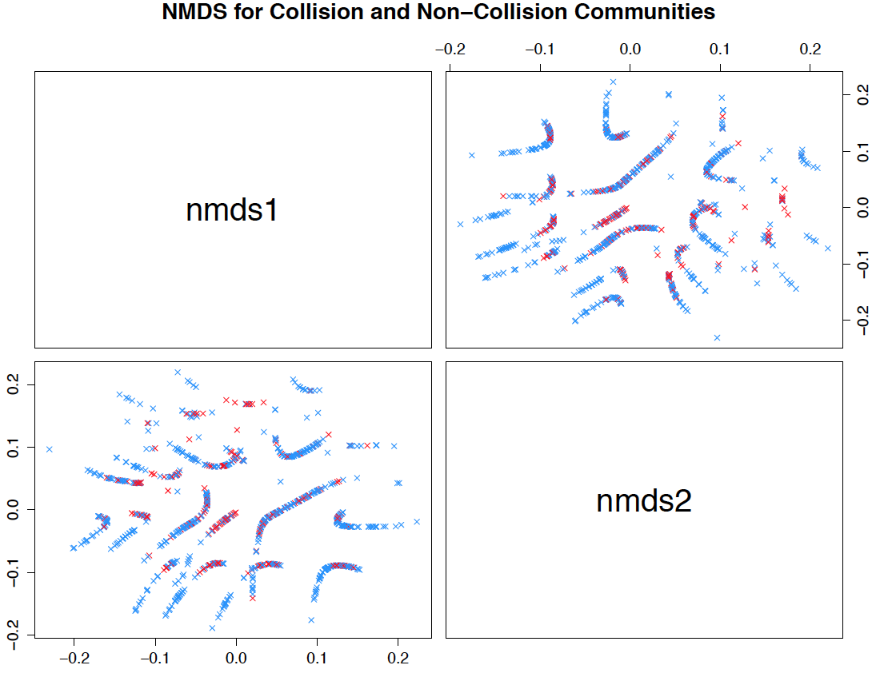
NDMS

Slide 8
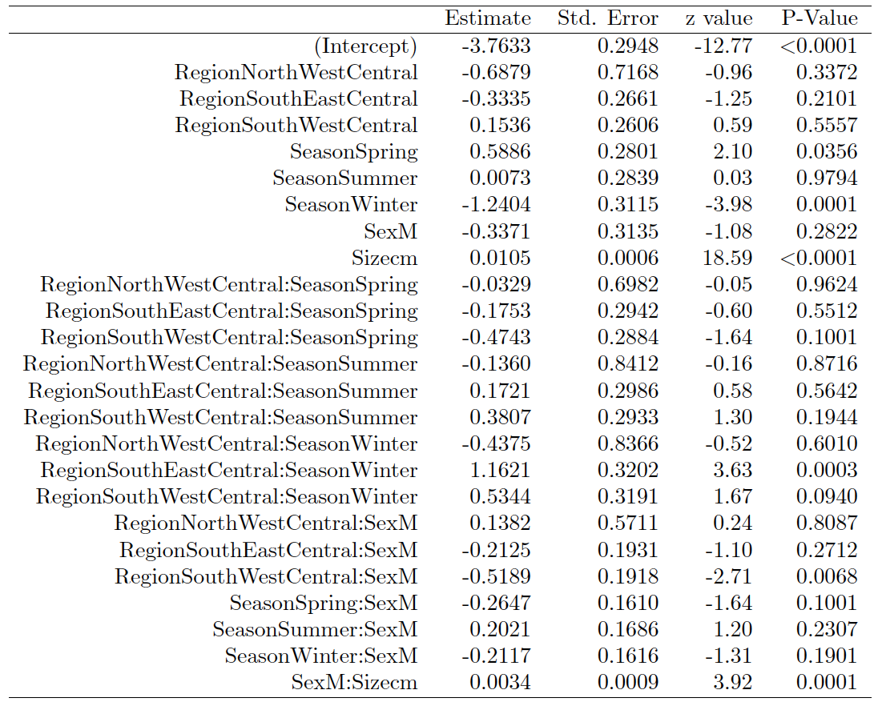

Slide 9
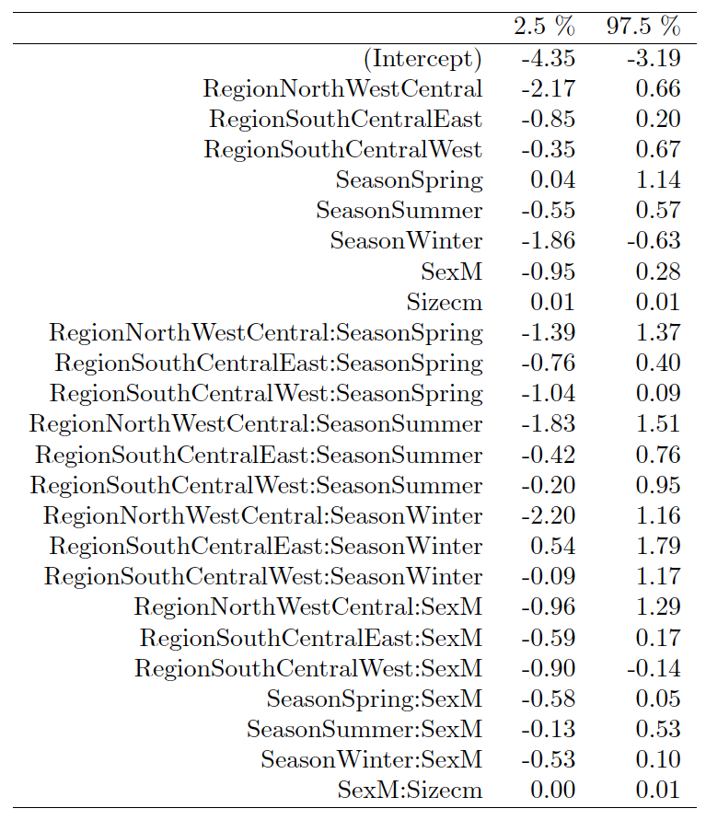
Confidence Interval for Parameters

